Slide 1
CHATTY - CHAT APPLICATION
JAYESH JHAWAR
1032212570
Course Name: Full Stack Development
Course Teacher: Dr. Alka Barhatte

Slide 2
Introduction
Aim: To develop a lightweight, modern, and responsive chat application that allows users to communicate in real-time using a secure and intuitive interface.
Objectives:
Design and implement a real-time chat interface using modern frontend tools.
Enable one-on-one and group communication with persistent messages.
Integrate WebSocket-based real-time messaging using Socket.IO.
Ensure responsive design with Tailwind CSS and DaisyUI.
Maintain clean, reusable code using React and Zustand for state management.
Deploy the application for local and future online hosting.

Slide 3
Tech Stack
Frontend: React.js, Tailwind CSS, DaisyUI, Vite
Backend: Node.js, Express.js
Database: MongoDB
Others:
WebSocket: Socket.IO
State Management: Zustand
HTTP Client: Axios
Routing: React Router DOM
Version Control: Git & GitHub
Linting & Formatting: ESLint
Build Tool: Vite

Slide 4
System Architecture
Frontend – React (Vite)
Entry Point: main.jsx
Mounts <App /> to #root in index.html
Routing: React Router
Defined in App.jsx
Pages: HomePage, LoginPage, SignUpPage, ChatRoom, etc.
State Management: Zustand
useAuthStore: Manages login/logout/auth check
useChatStore: Handles messages, user list
useThemeStore: Manages light/dark mode
Styling:
Tailwind CSS with DaisyUI themes
Configured via index.css and tailwind.config.js
Real-Time Communication:
Socket.IO client used for messaging and online user tracking
Backend – Express.js (Node.js)
Entry Point: index.js
Starts server, connects to MongoDB, initializes Socket.IO
Database: MongoDB (via Mongoose)
User Model: email, password, profilePic
Message Model: senderId, receiverId, text/image, timestamps
Authentication:
JWT-based
Middleware: protectRoute validates tokens
Token generation handled in utils.js
Real-Time Communication:
Socket.IO events configured in socket.js (join room, send message, disconnect, etc.)
File Uploads:
Used Cloudinary for uploading profile pics & image messages

Slide 5
Data Flow
Frontend
Authentication Flow:
User logs in / signs up → useAuthStore
JWT stored in cookies → sent with every secure request
Chat Flow:
Axios fetches chat history & user data → useChatStore
Real-time updates → Socket.IO listens/emits events
Theme Management:
useThemeStore controls app theme → synced with DaisyUI
Backend
Authentication:
Token created at login/signup
Middleware (protectRoute) secures private routes
Chat Handling:
Messages stored in MongoDB
Emitted to receivers via Socket.IO
File Upload Flow:
Image/file → uploaded to Cloudinary
URL stored in MongoDB for retrieval

Slide 6
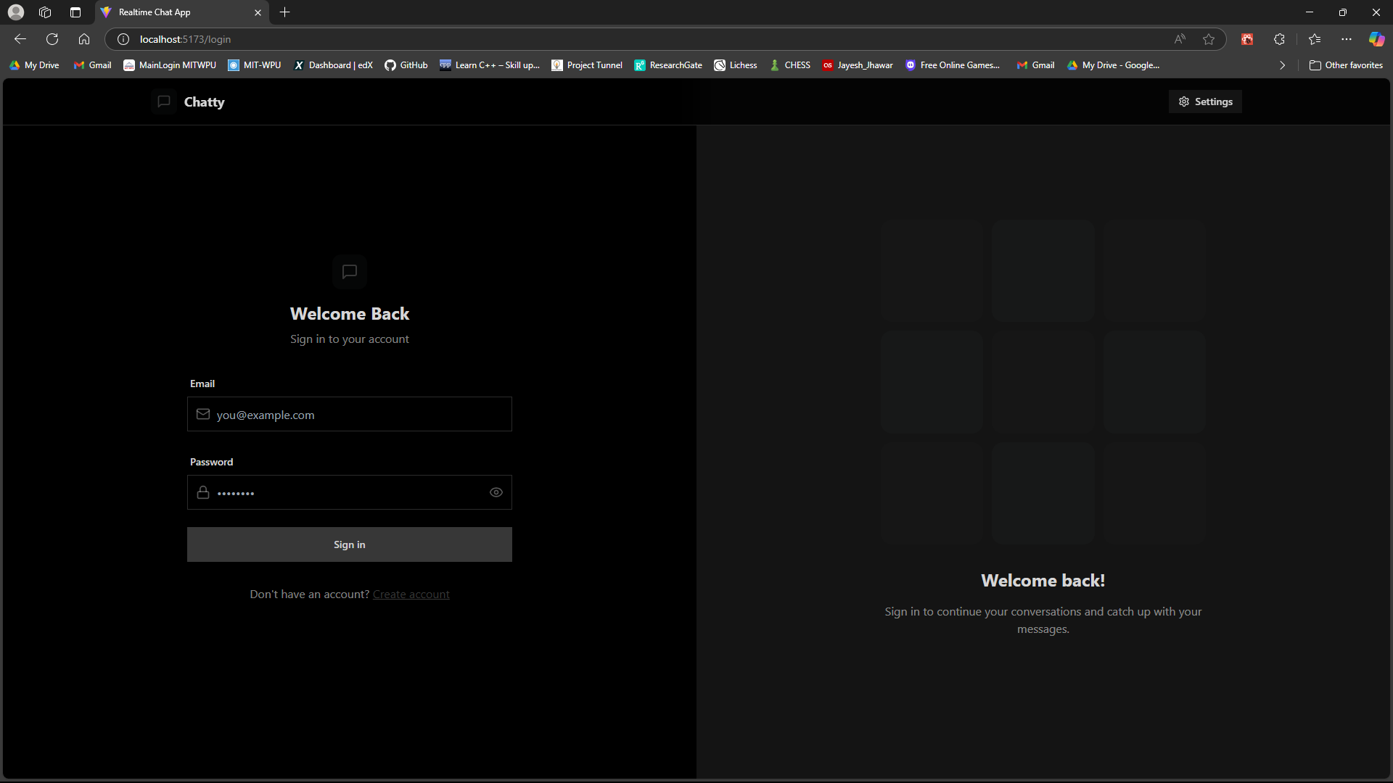
UI/UX Design (Frontend)

Slide 7
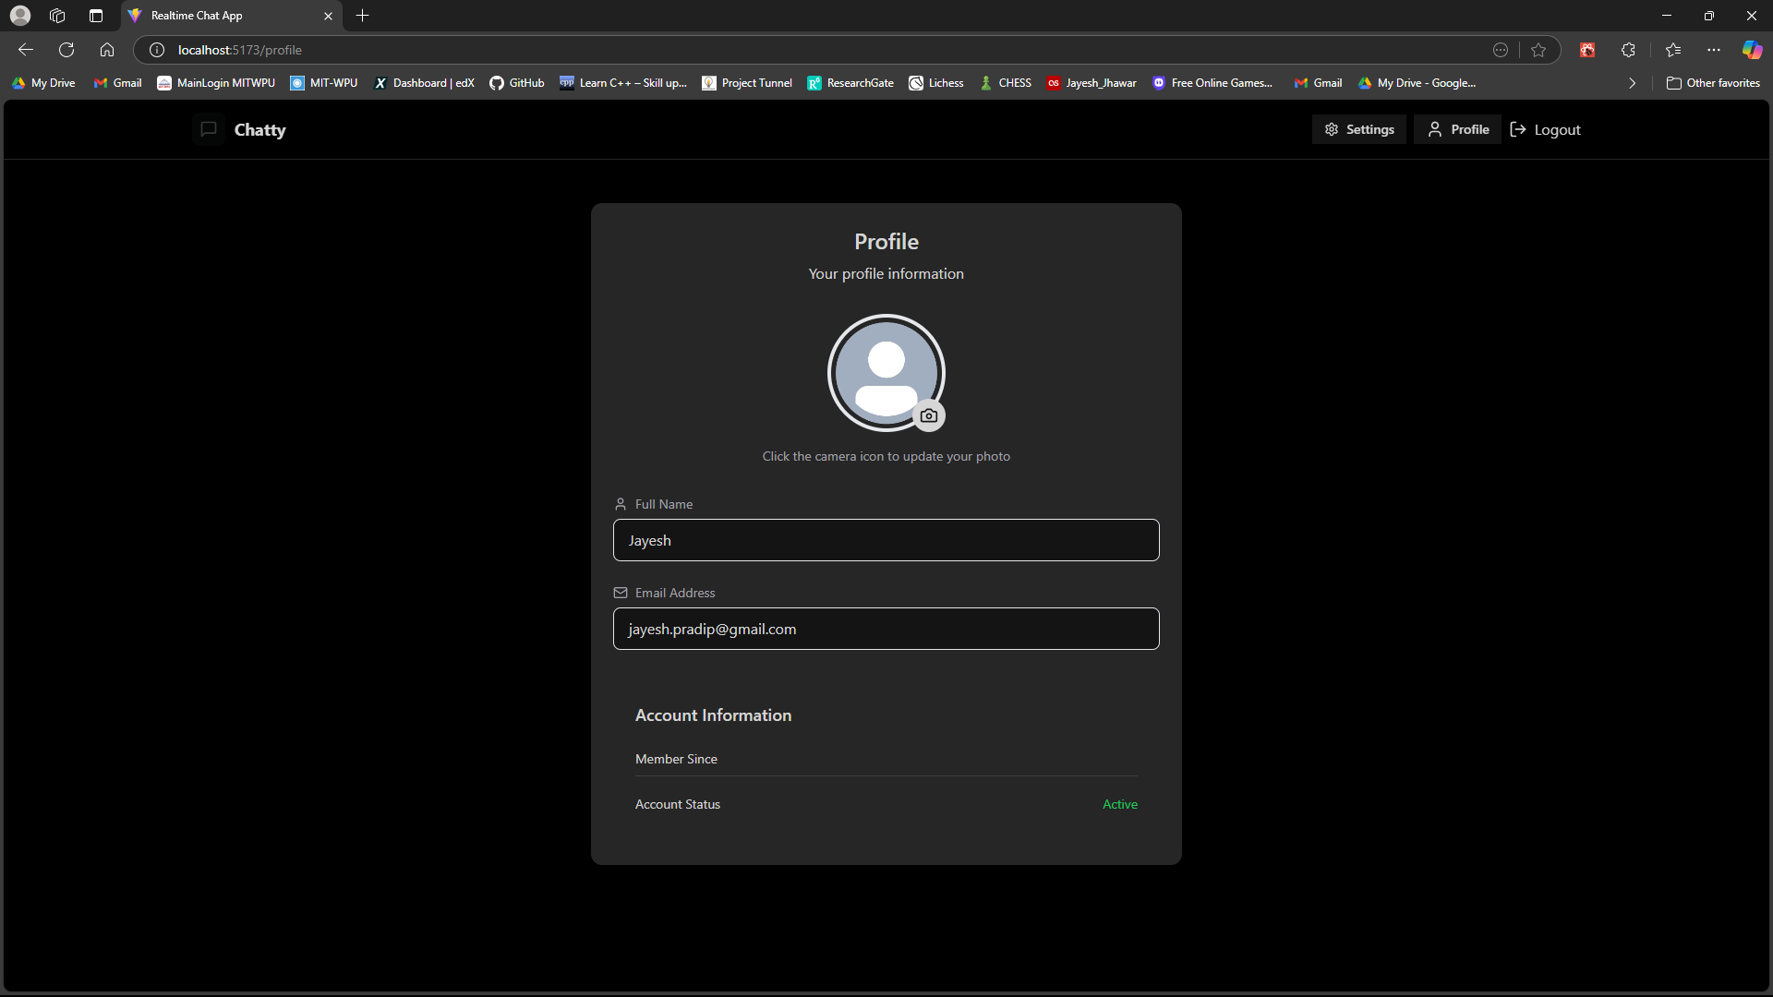
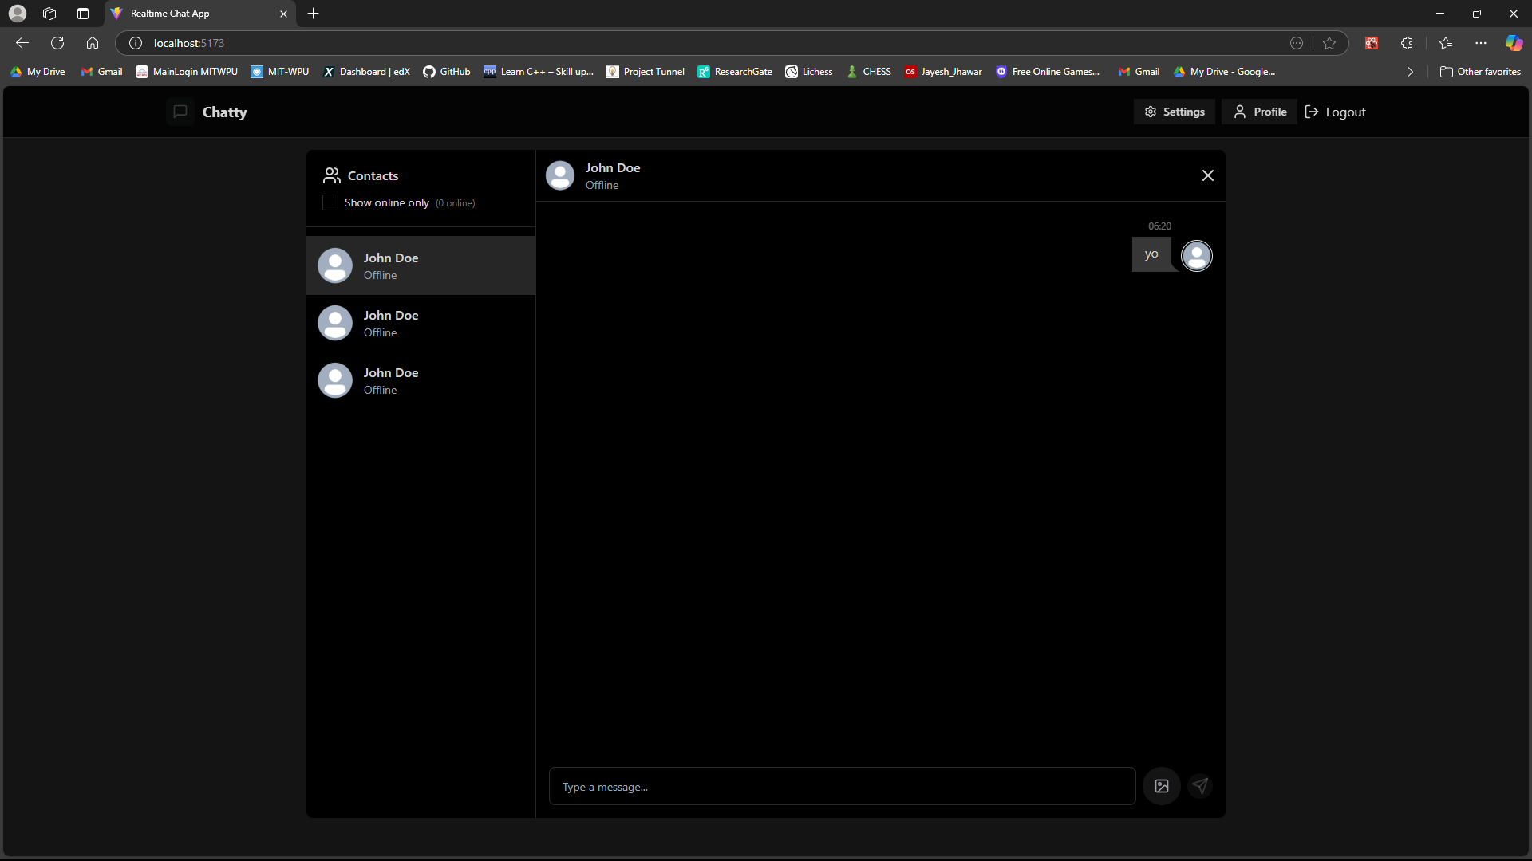
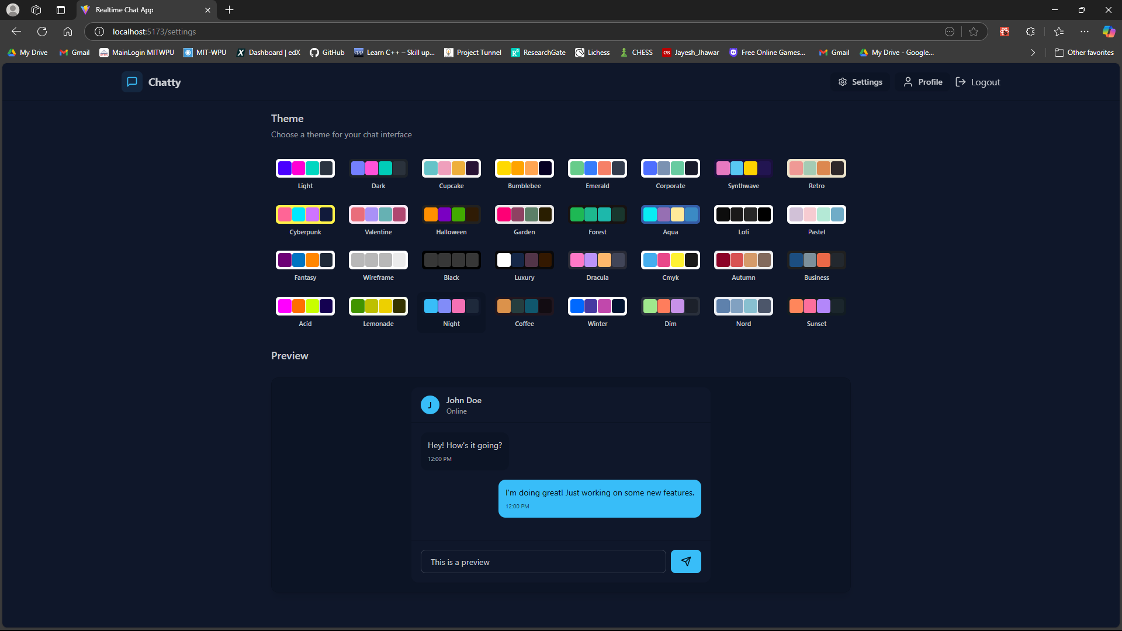
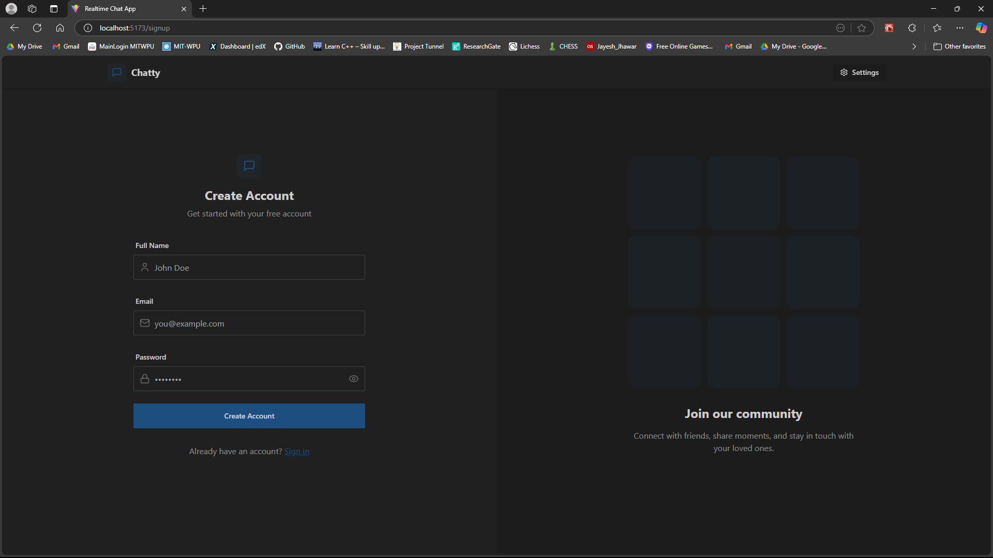

Slide 8
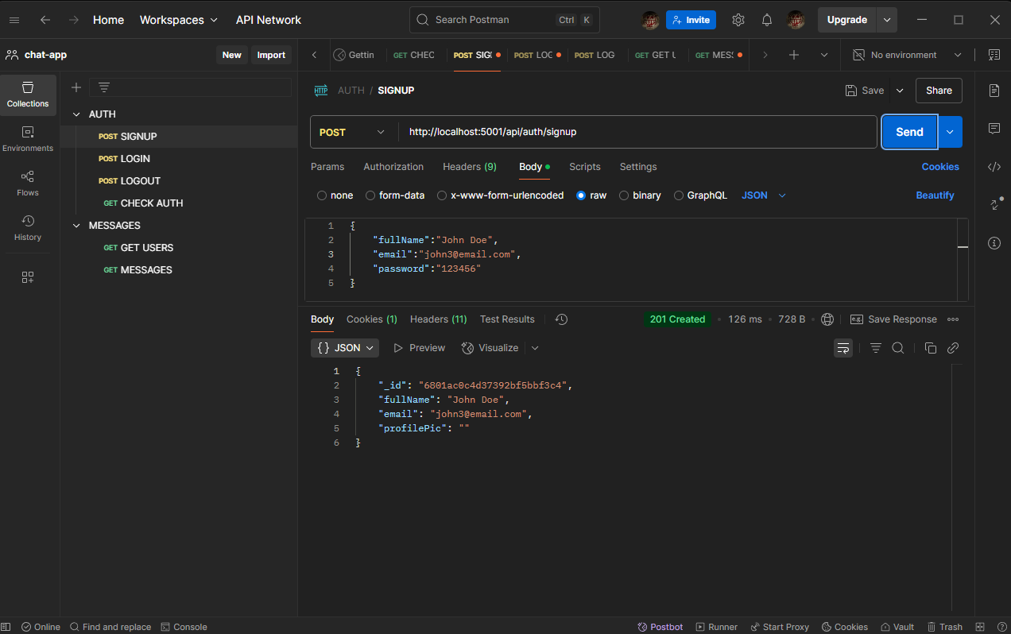
API ENDPOINTS
POST /api/auth/signup Functionality: Registers a new user.
POST /api/auth/login Functionality: Logs in an existing user.
POST /api/auth/logout Functionality: Logs out the user by clearing the JWT cookie.
GET /api/auth/check Functionality: Verifies if the user is authenticated.
GET /api/messages/users Functionality: Fetches all users except the logged-in user for the sidebar.

Slide 9
Database Design – User Side
Field | Type | Description
_id | ObjectId | Unique identifier for the user
email | String | User's email address
fullName | String | User's full name
password | String | Hashed password
profilePic | String | URL of the user's profile picture
timestamps | Date | Auto-generated createdAt and updatedAt fields

Slide 10
Database Design – Messages
Field | Type | Description
_id | ObjectId | Unique identifier for the message
senderId | ObjectId | Reference to the sender's user ID
receiverId | ObjectId | Reference to the receiver's user ID
text | String | Text content of the message
image | String | URL of the attached image (if any)
timestamps | Date | Auto-generated createdAt and updatedAt fields

Slide 11
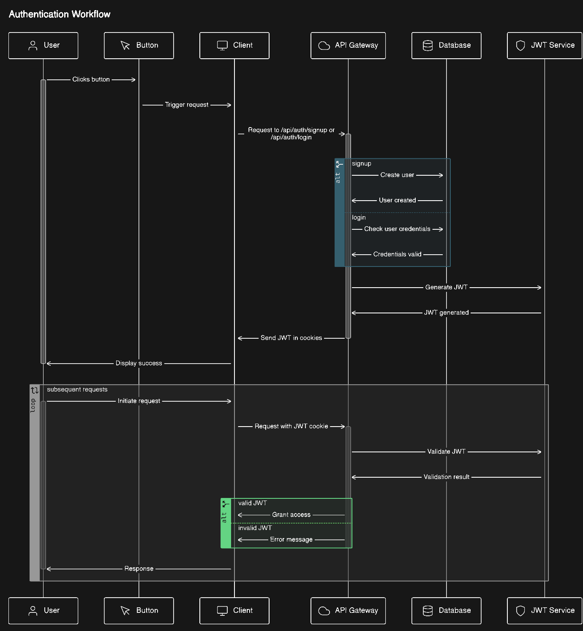
Authentication and Authorization

Slide 12
Login and Signup Flow
Signup Flow
User Input: User provides fullName, email, and password.
Validation:
Check if all fields are provided.
Ensure the password is at least 6 characters long.
Verify if the email is unique.
Password Hashing:
Use bcrypt to hash the password before storing it in the database.
Token Generation:
Generate a JWT token and store it in an HTTP-only cookie.
Response:
Return the user details (excluding the password).
Login Flow
User Input: User provides email and password.
Validation:
Check if the email exists in the database.
Compare the provided password with the hashed password using bcrypt.
Token Generation:
Generate a JWT token and store it in an HTTP-only cookie.
Response:
Return the user details (excluding the password).

Slide 13
Learnings from the Process and Key Takeaways
Technical Skills:
Gained hands-on experience with Socket.IO, Cloudinary, and JWT-based authentication.
Improved understanding of MongoDB schema design and Mongoose.
Problem-Solving:
Learned how to break down complex problems into smaller, manageable tasks.
Developed a systematic approach to debugging and testing.
User-Centric Design:
Understood the importance of designing intuitive and responsive user interfaces.
Adaptability: Learned to adapt to new tools and frameworks quickly.
Scalability: Designed the application with scalability in mind, ensuring it can handle more users and features in the future.
Security: Gained a deeper understanding of securing web applications, especially with authentication and data validation.

Slide 14
Future Scope / Enhancements
Message Reactions
Typing Indicators
Read Receipts
Two-Factor Authentication (2FA)
End-to-End Encryption
Rate Limiting
Track user activity
Multi-Language Support
Mobile Application

Slide 15
Conclusion
The development of Chatty successfully demonstrates the integration of modern web technologies to build a responsive, real-time chat application. Through the use of React, Node.js, MongoDB, and Socket.IO, the project not only delivers essential chat functionalities but also emphasizes clean architecture, user experience, and scalability. This journey has enriched both technical and problem-solving skills while laying a strong foundation for future enhancements like E2E encryption, 2FA, and mobile compatibility, positioning Chatty as a robust and extensible communication platform.

Slide 16
Packages and References
Package | Purpose | Reference Link
axios | Promise-based HTTP client for the browser and Node.js | axios on npm
lucide-react | Icon library for React based on Lucide (Feather icons fork) | lucide-react on npm
react | Core React library for building UIs | react on npm
react-dom | Allows React to interact with the DOM | react-dom on npm
react-hot-toast | Toast notifications for React | react-hot-toast on npm
react-router-dom | Routing library for React (DOM version) | react-router-dom on npm
socket.io-client | Client-side Socket.IO for real-time communication | socket.io-client on npm
zustand | Lightweight state management for React | zustand on npm

Slide 17
Packages and References
Package | Purpose | Reference Link
@eslint/js | ESLint’s main config module | @eslint/js on npm
@types/react | TypeScript definitions for React | @types/react on npm
@types/react-dom | TypeScript definitions for React DOM | @types/react-dom on npm
@vitejs/plugin-react | Vite plugin to support React JSX, Fast Refresh, etc. | @vitejs/plugin-react on npm
autoprefixer | PostCSS plugin to add vendor prefixes | autoprefixer on npm
daisyui | Tailwind CSS component library | daisyui on npm
eslint | Linter for JavaScript | eslint on npm
eslint-plugin-react | ESLint rules for React | eslint-plugin-react on npm
eslint-plugin-react-hooks | ESLint rules for React hooks | eslint-plugin-react-hooks on npm
eslint-plugin-react-refresh | Enables Fast Refresh linting in React | eslint-plugin-react-refresh on npm
globals | Provides global variable definitions for ESLint | globals on npm
postcss | CSS transformation tool (used with Tailwind) | postcss on npm
tailwindcss | Utility-first CSS framework | tailwindcss on npm
vite | Frontend build tool and dev server | vite on npm

